Slide 1
SpArk Funds,INVESTMENT CASE STUDY SUBMISSION
Submitted By:
Payal Ashokrao Mandulkar

Slide 2
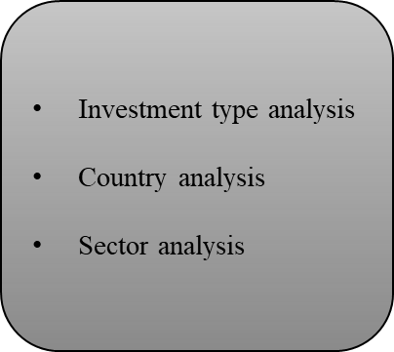
Abstract :
Spark Funds wants to make investments in a few companies. The Spark Funds wants to understand the global trends in investments so that they can take the investment decisions effectively.
Constraints
Constraints
Business Objectives
Data Analysis
Invest between 5 to 15 million USD per round of investment.
Invest only in English speaking countries.
Identify the best sectors,
Countries, and
A suitable investment type for making investments.

Slide 3
Problem Solving Approach:
START
Extract venture,PE,seed,angel data
mapping
Companies
rounds2
Top3 English country
Uppercase permalink
Uppercase company permalink
Extract primary sec and add new col in main frame as PS
Rename categary_list column to primary_sec
5m<=raised_amount_usd<=15m
Inner join on permalink
Melt function for 1-1 mapping
yes
Left Join
Select funding the type
Column with insufficient data
Row>5 null vules
yes
No
yes
Drop rows
Select top3
based on sum of inv amt
D1,D2,D3 data frames,plots
Drop column
END
No

Slide 4
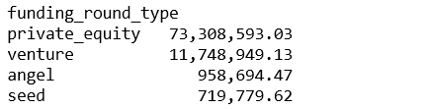
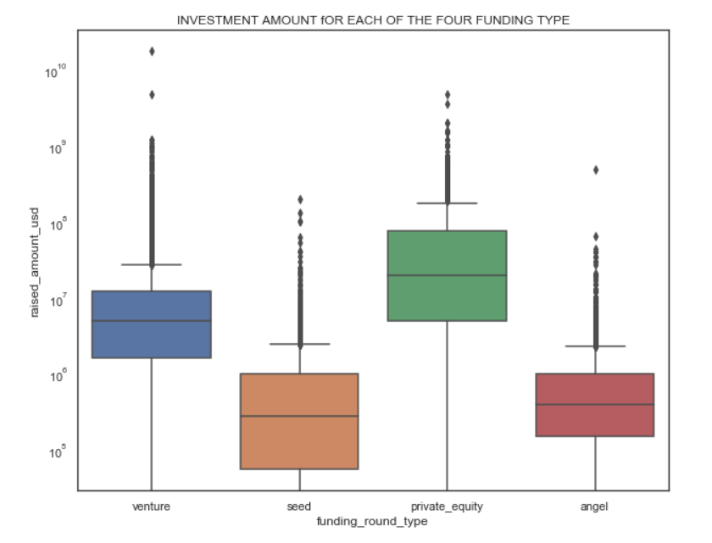
Investment Type Analysis
Can be analyzed from plot ,though private equity seems to have raised higher funds, sparks funds cant select it. as it does not fall in constraint 5 to 15 million usd per round of investment.
Average funding of venture is second highest and falls with in 5 to 15 million usd per round of investment.

Slide 5
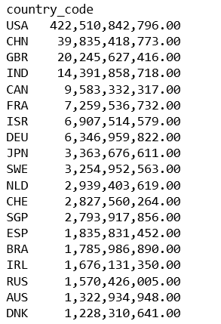
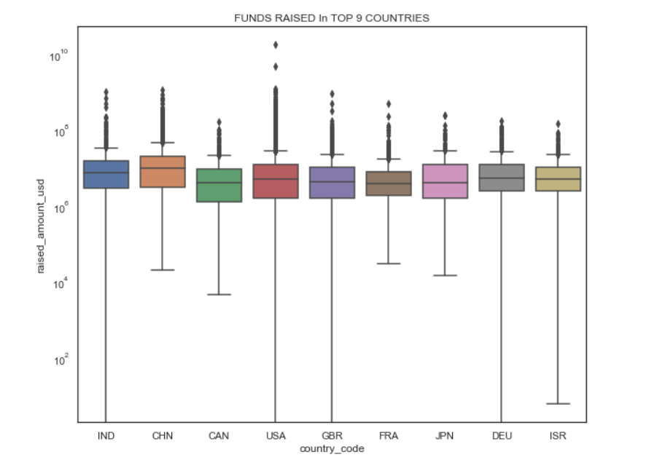
Country Analysis :

Slide 6
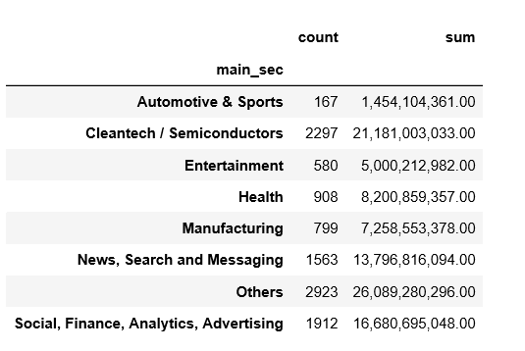
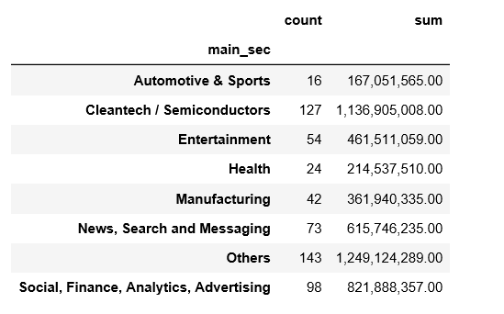
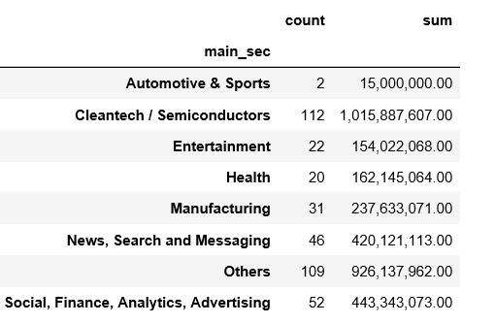
top 3 sectors of the top 3 countries
USA
GBR
CAN

Slide 7
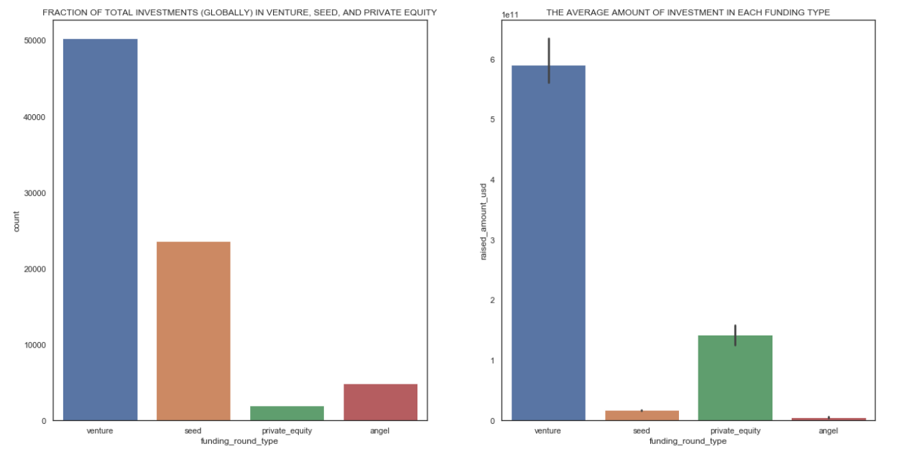
Fraction of total investments (globally) in venture, seed, and private equity, and the average amount of investment in each funding type.

Slide 8
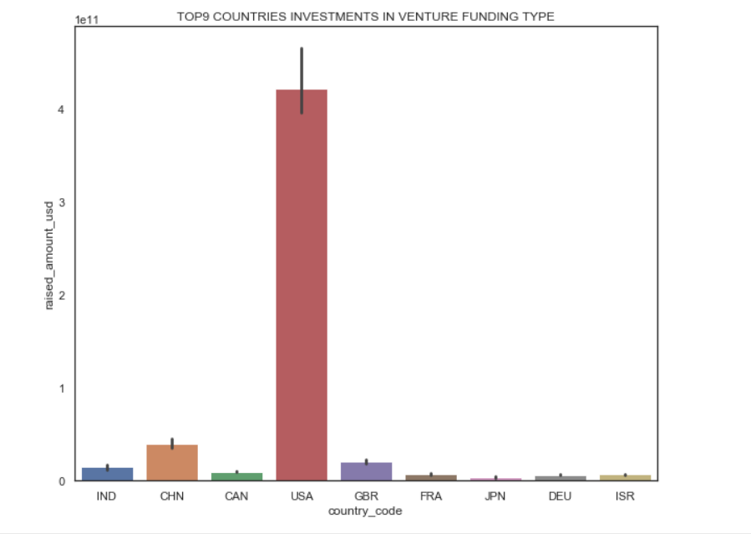
Top 9 countries against the total amount of investments of funding type.

Slide 9
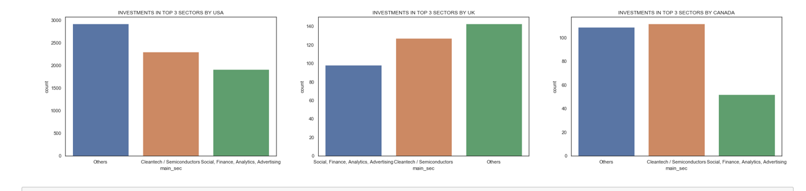
top 3 sectors of the top 3 countries

Slide 10

Inference:
Top 3 English speaking Countries to invest are
USA
UK
CANADA
Top 3 Best Sectors
Others
Cleantech / Semiconductors
Social, Finance, Analytics, Advertising
Best Funding type suited for our need is ‘Venture’

